Slide 1
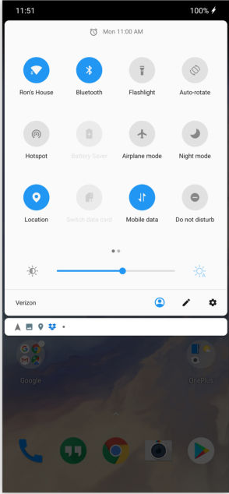

Slide 2
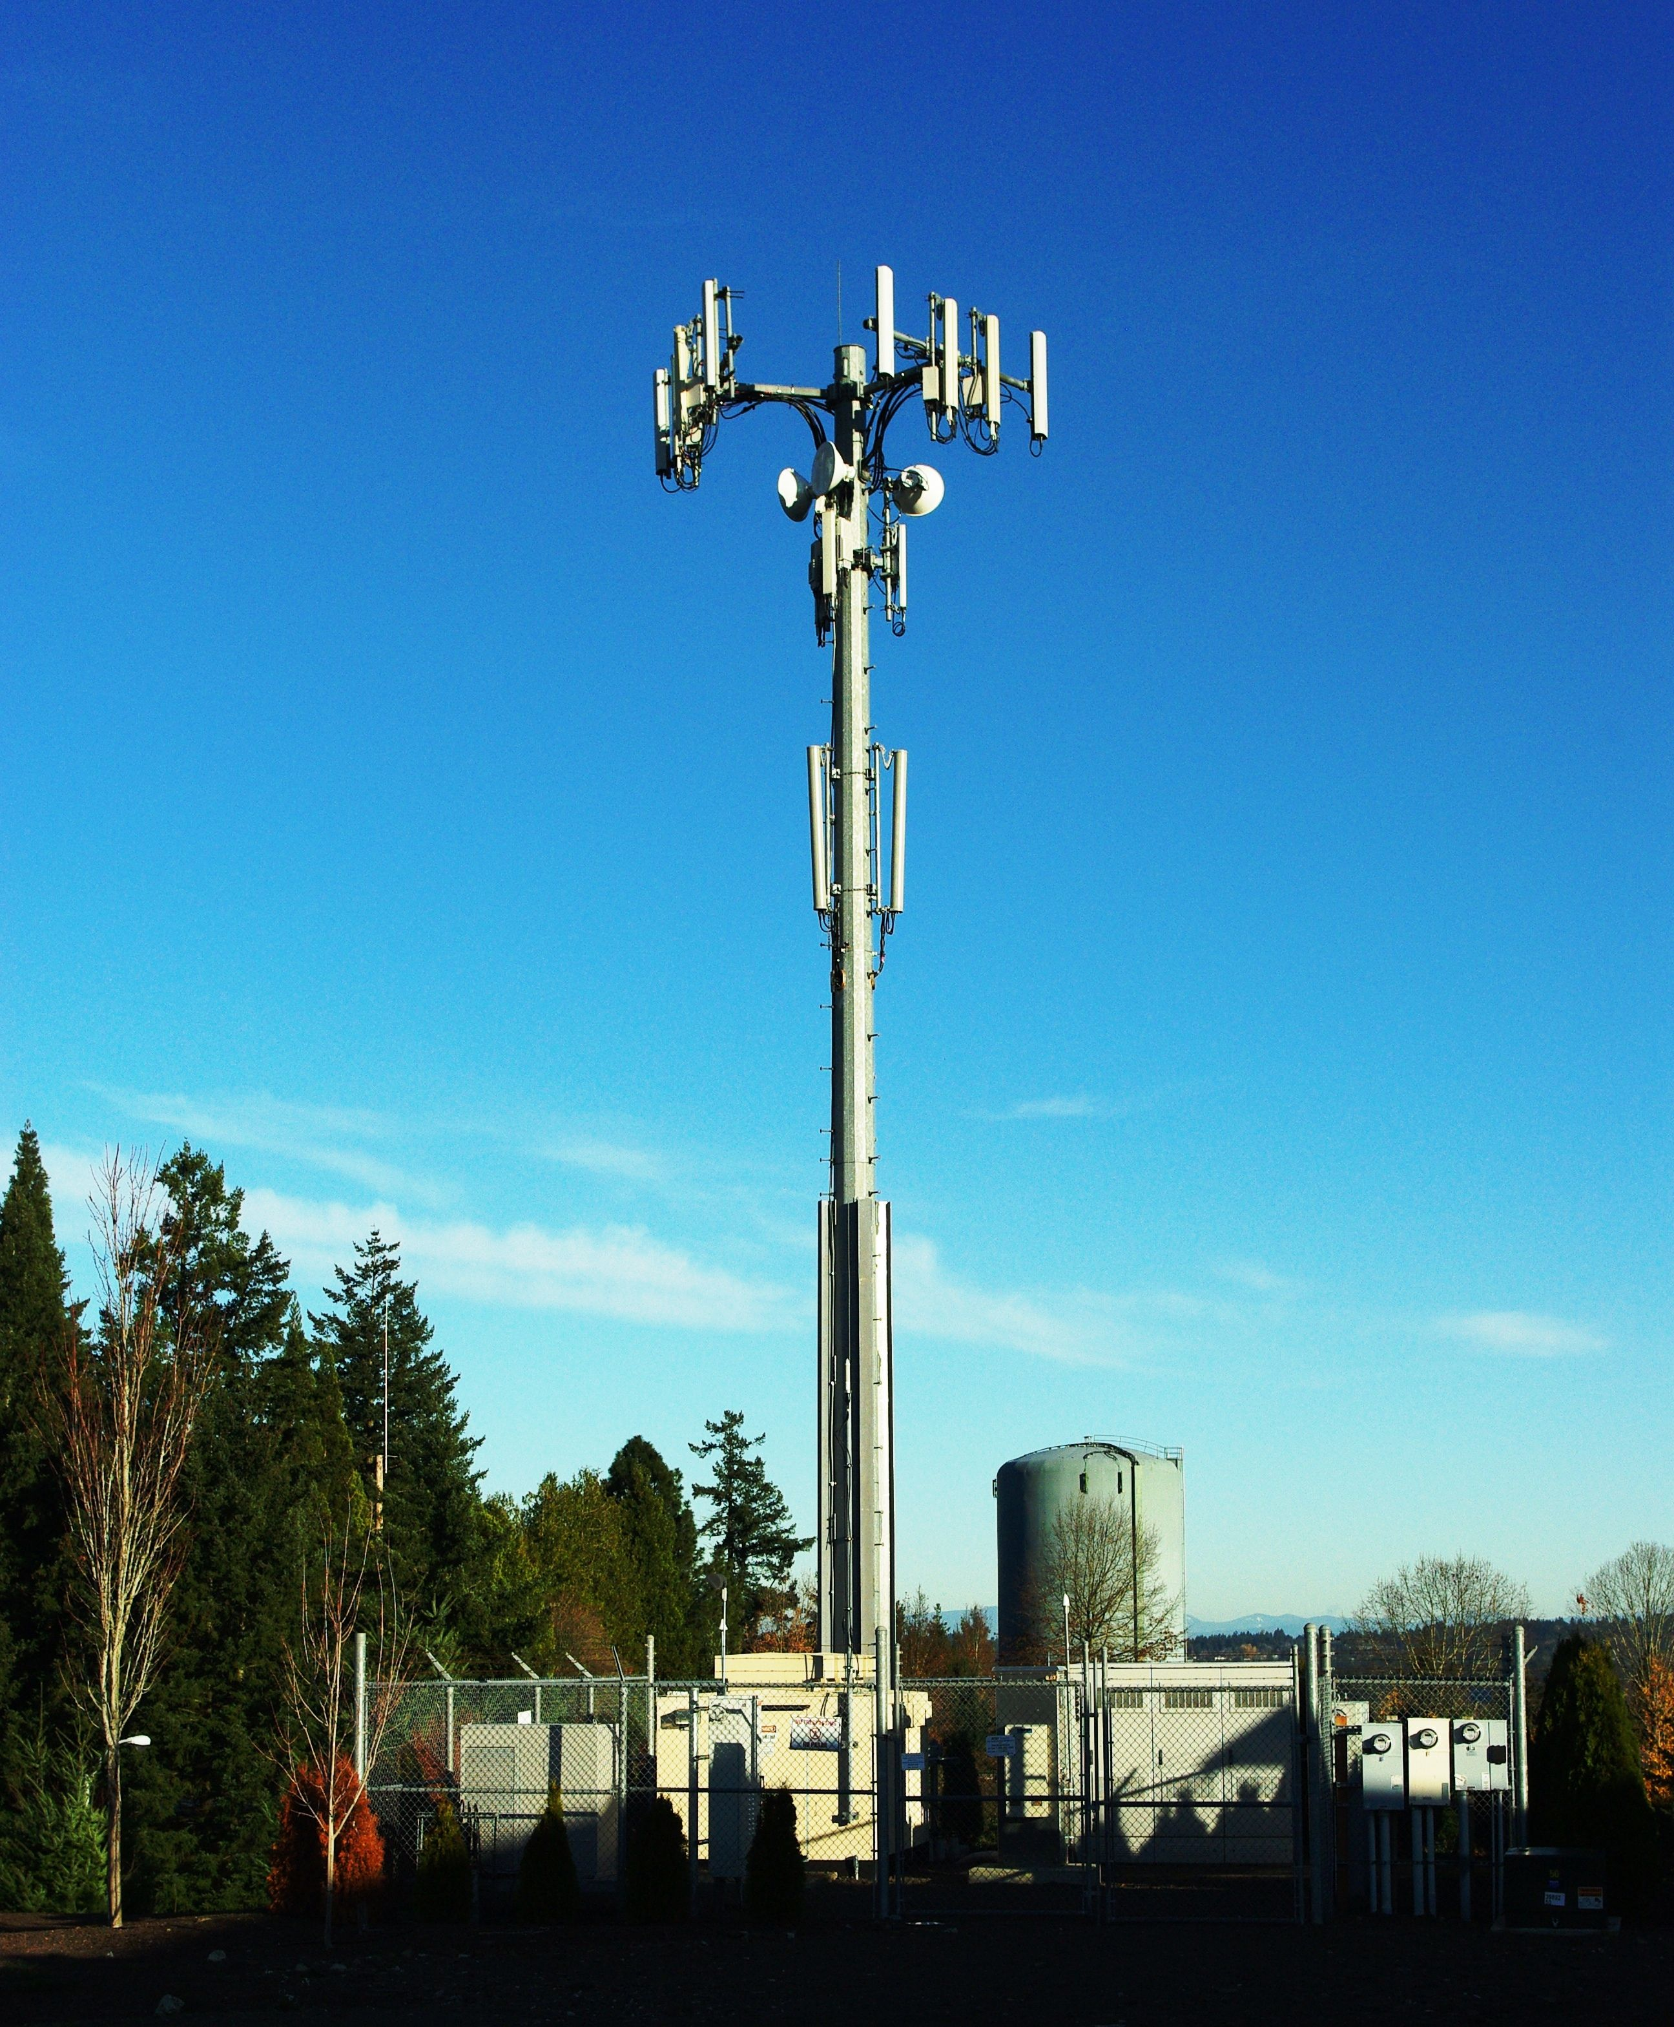
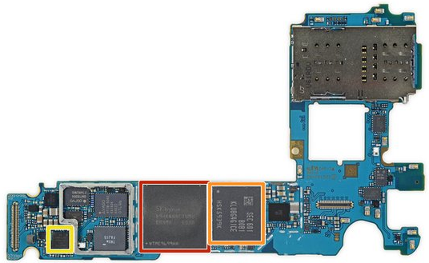

Slide 3
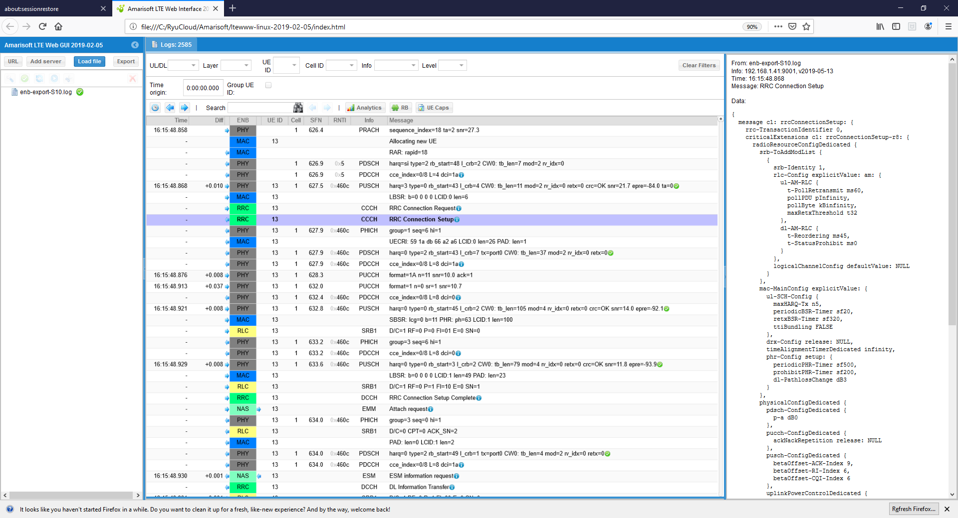

Slide 4
Samsung Note 10+ Teardown - TWO Wireless Chargers?
https://www.youtube.com/watch?v=-f7B9fBJJug
iPhone 11 Pro Max Teardown - Tiny Motherboard & BIG Battery!
https://www.youtube.com/watch?v=dVZKn6NSmNg

